Slide 1
Final Project STAC51
Analyzing Credit Risk
Alex Cheng, Zaamin Rattansi, Jacob Temple, & Jeffrey Wong

Slide 2
Introduction
The purpose of this research is to study the direct and indirect relationships of several factors related to credit risk. This will be done through a thorough analysis of the variables that have an effect on the credit risk of an individual. Variables that are directly related and variables that have less importance were included to see a larger range of relationships possible and to really understand what what characteristics of a person's financials have the greatest effect on their credit risk.

Slide 3
Background
The data we have analyzed and studied is taken from the Beuth University of applied sciences Berlin.
The data was taken to analyze the importance of different factors that affect credit risk.
This data was taken in the 70’s so it may be outdated, for example, one variable is the presence of a landline.

Slide 4
Study Goal
To analyze what variables cause an increase or decrease in credit risk to learn more about what is required to have low credit risk.

Slide 5
Data Preparation
We split our data into 2 halves for cross validation. This is to prevent overfitting of our final model.

Slide 6
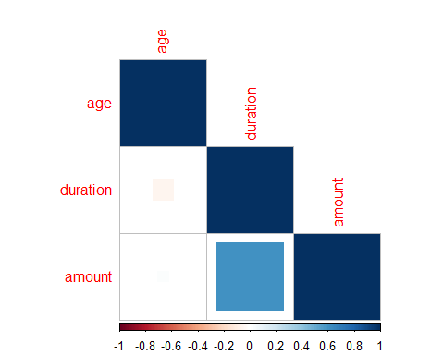
Description and Visualization of Data

Slide 7
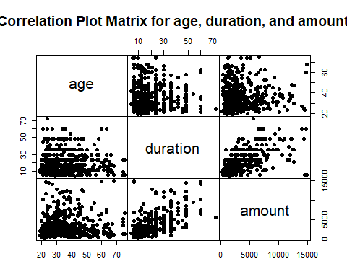

Slide 8
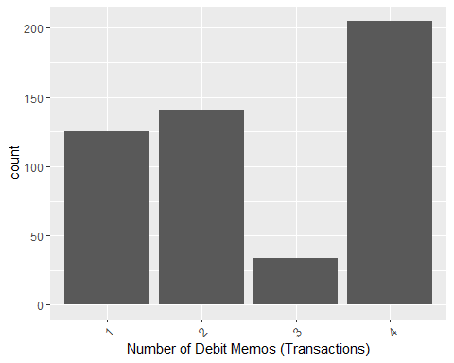
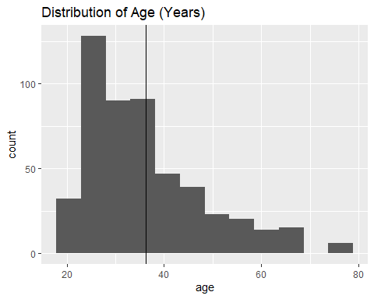
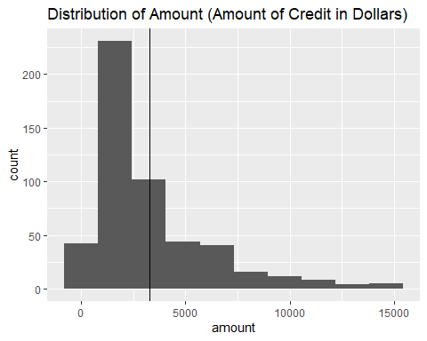
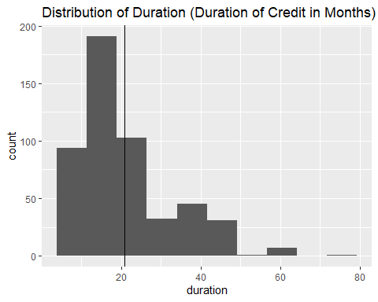

Slide 9
Model Building

Slide 10
Diagnoses
Predicted Probabilities

Slide 11
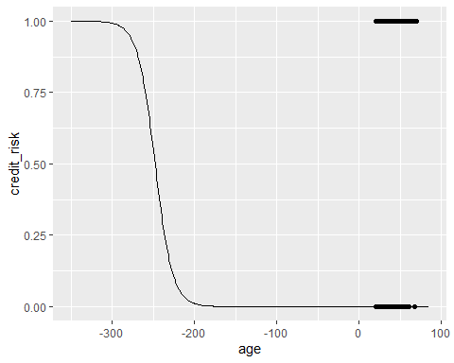

Slide 12
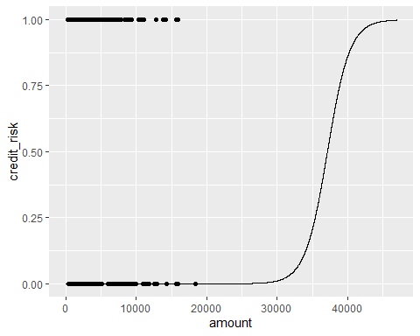

Slide 13
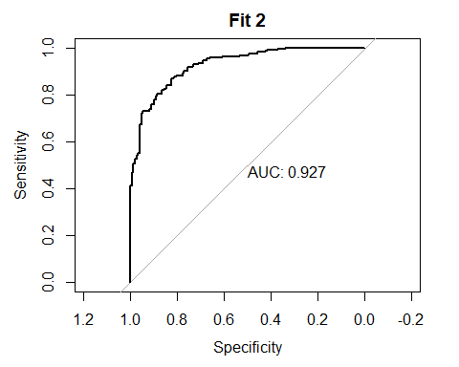

Slide 14
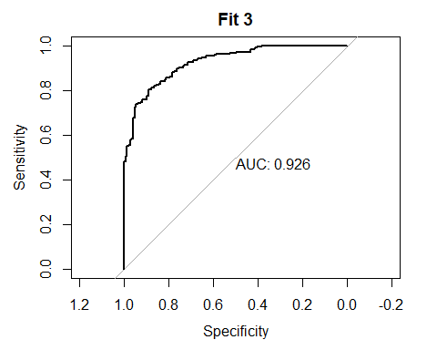

Slide 15
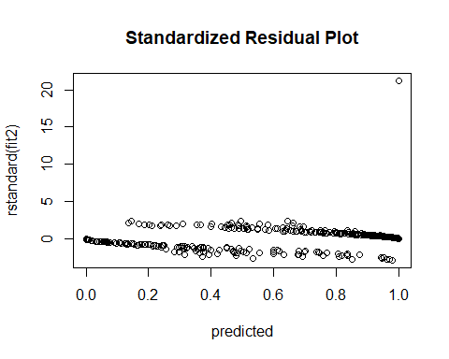

Slide 16
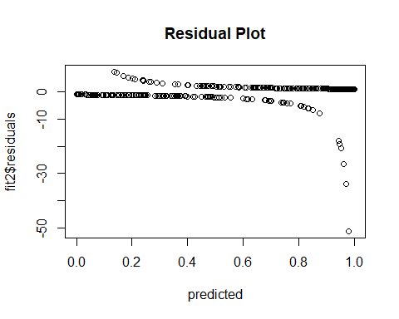

Slide 17
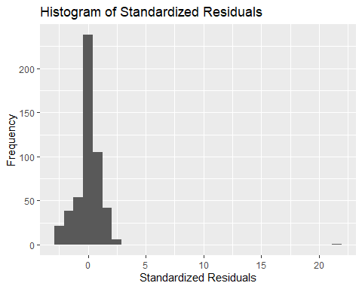

Slide 18
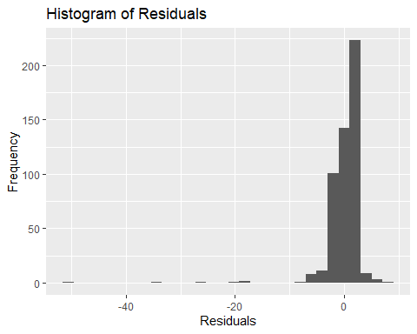

Slide 19
The residuals are most frequently valued around 0, with a few outliers with values less than -10 which should be removed from the data.

Slide 20
Conclusion
Our study resulted in few expected and unexpected findings. The variables we used allowed us to build an accurate and useful model to enable us to conclude which variables have the most and least effect on credit risk. The variable that stood out the most is job, the quality of the debtors job. This variable causes a huge dip in credit risk when the debtor has a high quality job whereas credit risk was high when the debtor had a low quality job, this was as expected. A variable that ended up having little effect on credit risk was the number of credits variable. It was expected that this would have a significant effect on credit risk but the number of credit accounts an individual has, resulted in little change to their respective credit risk.

